Slide 1
COMP3000 PROJECT
VARIANCE

Slide 2

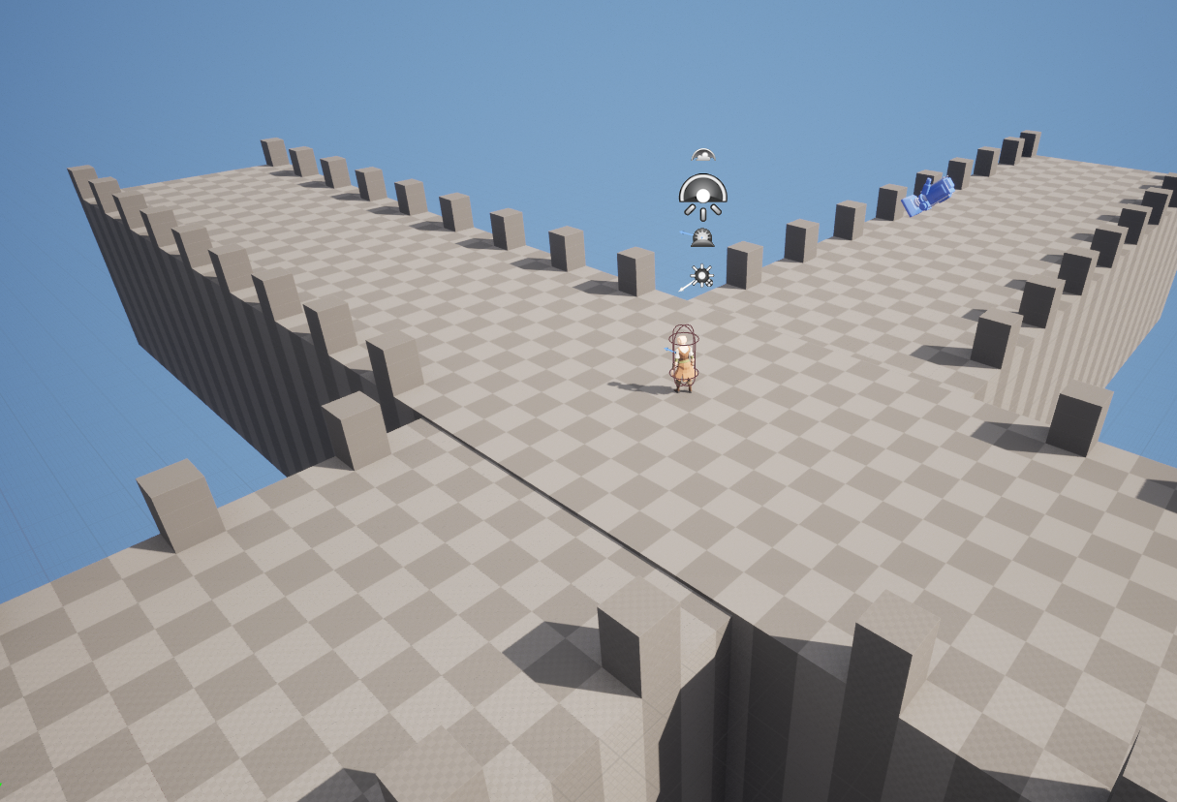
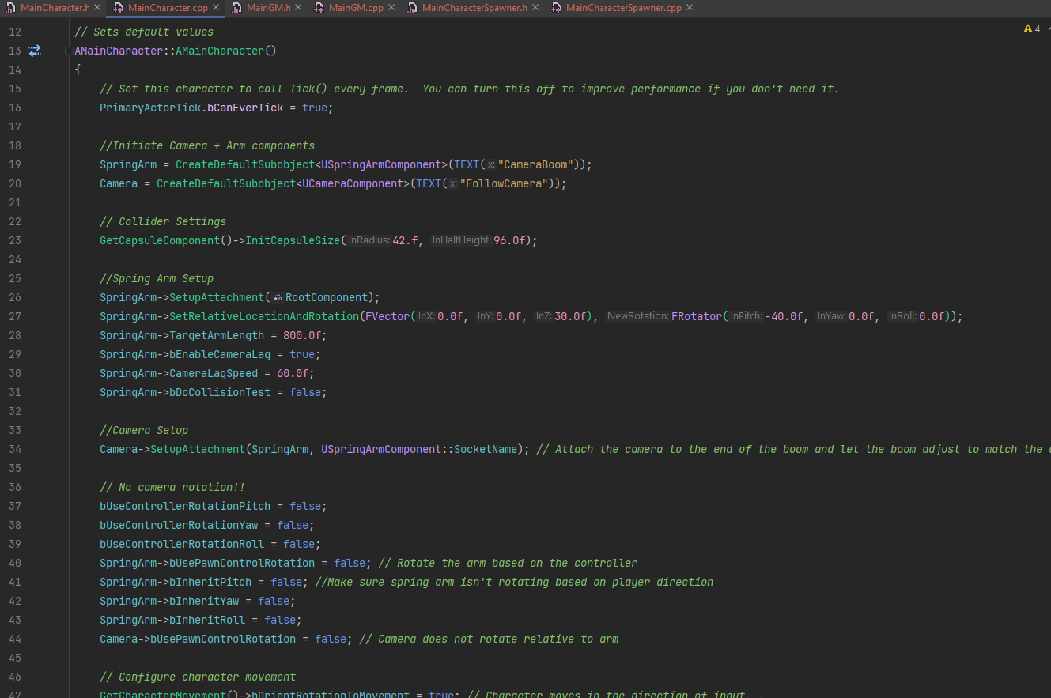
SPRINT 1 RESULTS
Completed basic top-down player controller in C++
Retargeted animations for new character model from UE5 mannequin default
Selected several external 3D assets to use
Planned out early methodology for dungeon generation

Slide 3
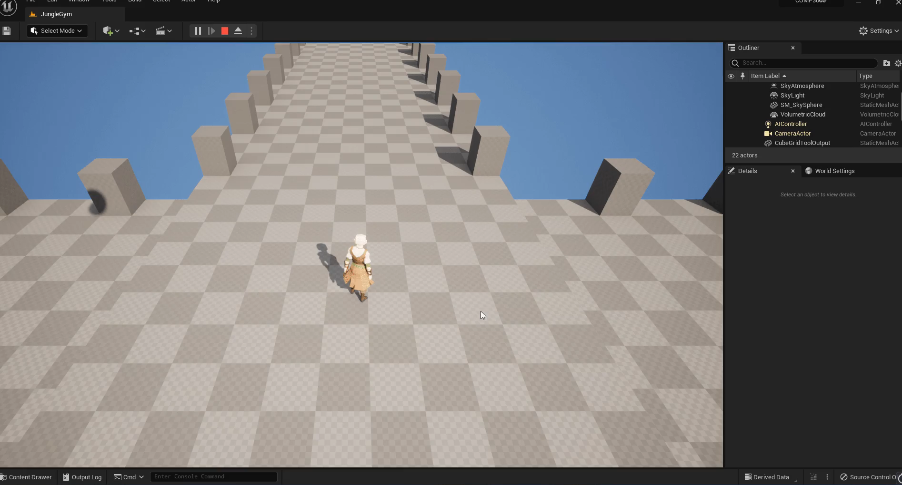

Slide 4
Sprint 2 goals
Add some interaction to the player (Dash, attack, sprint?)
Add custom animation state machine
Concept level design for rooms
Setup basic enemy controller

